Slide 1
AI Project – Drug & side-effect association network
Group Epsilon
Andrius Navasaitis, Daniel Scheitler, Isaac Lowry, Daniel Sewerynski

Slide 2
Introduction to the Dataset
This is a drug side-effect association network that contains information on side effects caused by drugs that are on the U.S. market. Sourced from SIDER Side Effect Resource (5681 nodes & 145321 edges)
Nodes represent drugs and side effects, and edges indicate recorded adverse drug reactions.
The information is extracted from public documents, package inserts, drug labels, off-label associations between drugs and side effects, and adverse event reporting systems that collect reports from doctors, patients and drug companies.

Slide 3
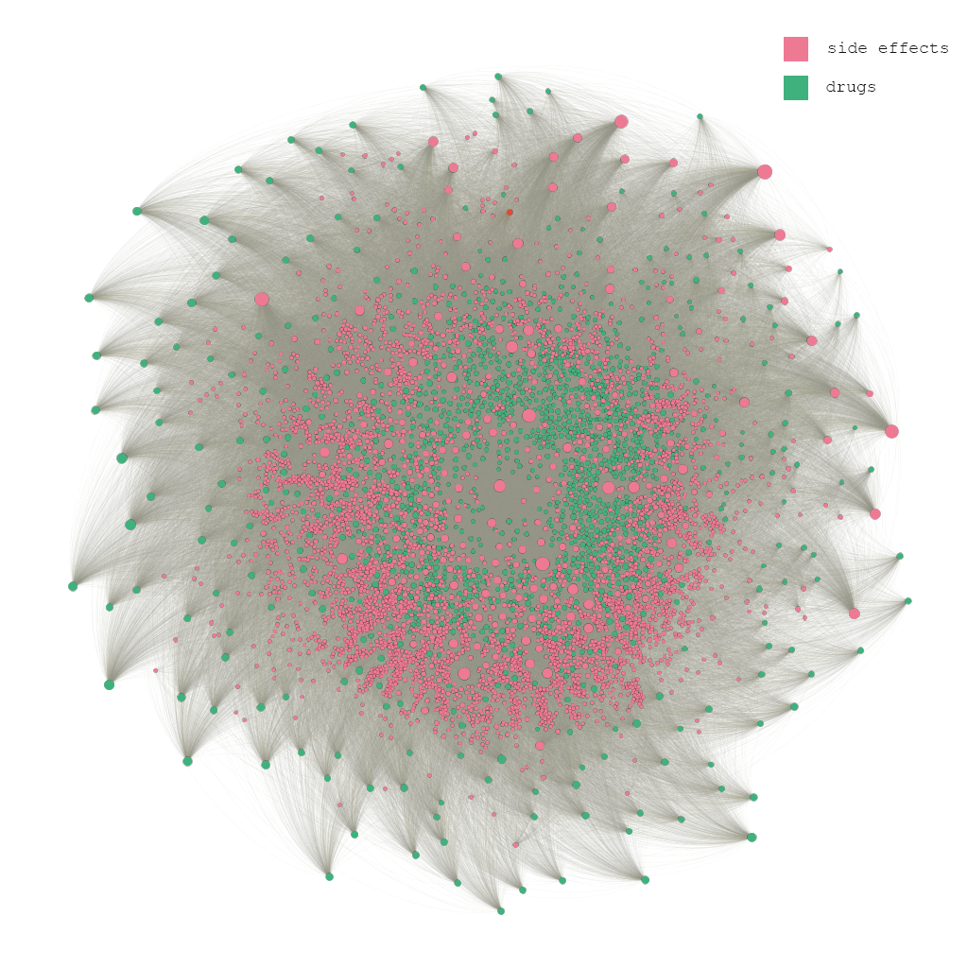
Visualisation of Network

Slide 4
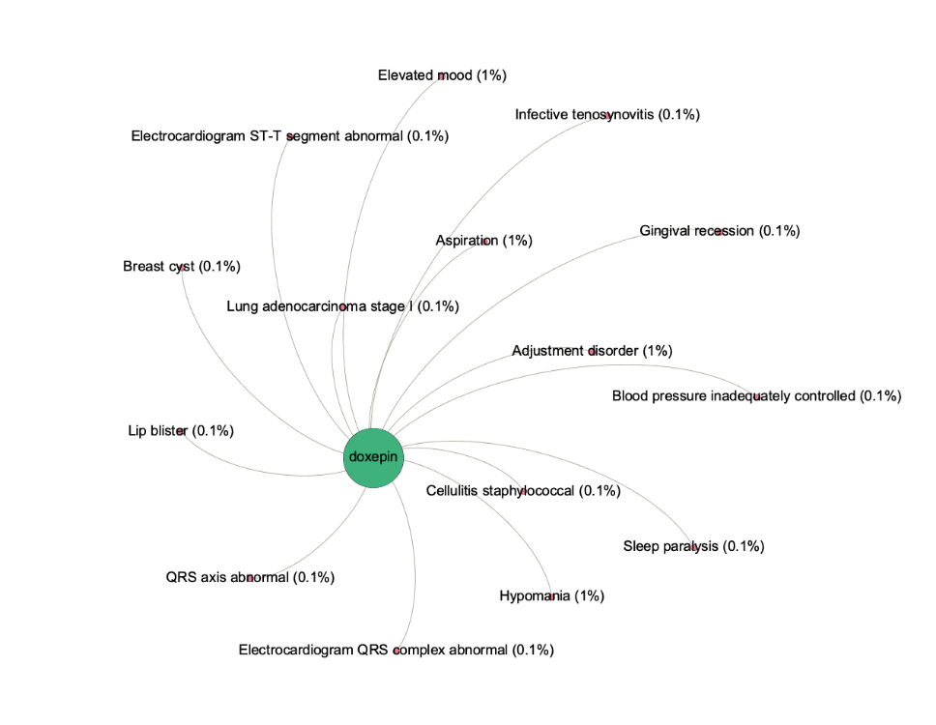
Individual Slice of Network

Slide 5
What we want to discover about the network
Discover different kinds of side effects and their percentage chance to surface when taking a particular drug.
Find out the most common side effects for any particular drug by utilising HITS algorithm.
Investigate which side effects are unique to a particular drug by utilising degeneracy.
Applying a threshold to the network and observe how many side effects are removed. This can be used to filter out the side effects which have a very low chance of occurrence.

Slide 6
Why we want to find out these things
Adverse side effect have the potential to cause debilitating discomfort or even death.
The nature of clinical trials does not allow the detection of all serious side effects and drug interactions before therapy for patients.
Gathering this data and computing it using AI lets us view the network in a more informative and interactive way. Additionally, the data (which is obtained from various sources) is standardised into one format and centralised into one place.

Slide 7
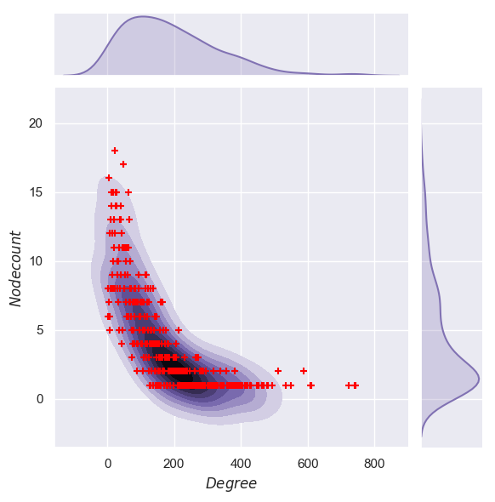
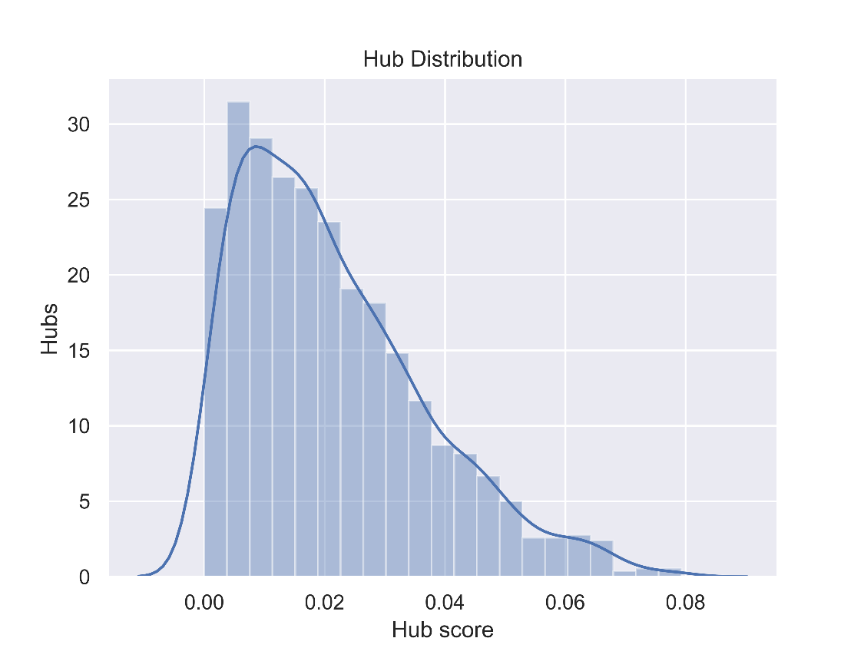
HITS Algorithm SNAP Program
Hyperlink Induced Topic Search (HITS), originally used to rate web pages. Based on the idea that a web page with a large number of incoming links must be important.
Identifies hubs (drugs) and authorities (side effects)
Our program contains 1430 hubs and 4251 authorities
Degree against node-count
Measure of hub score

Slide 8
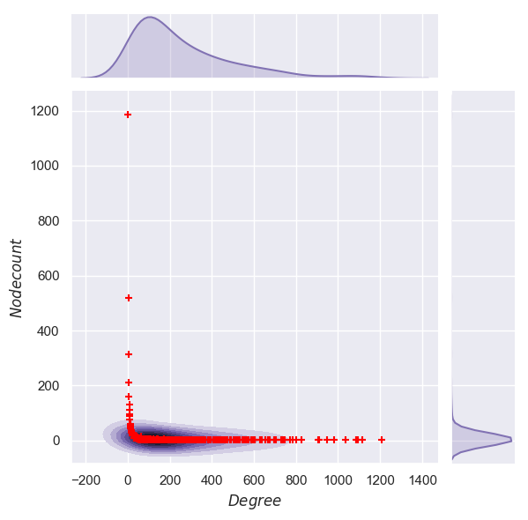
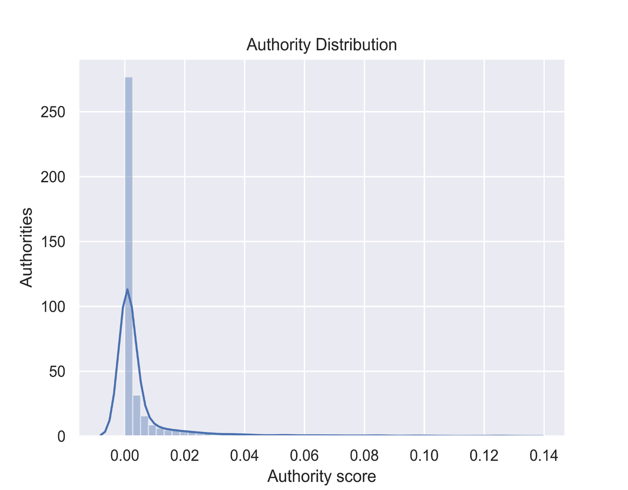
Visual Results
Degree against node-count
Measure of authority score

Slide 9
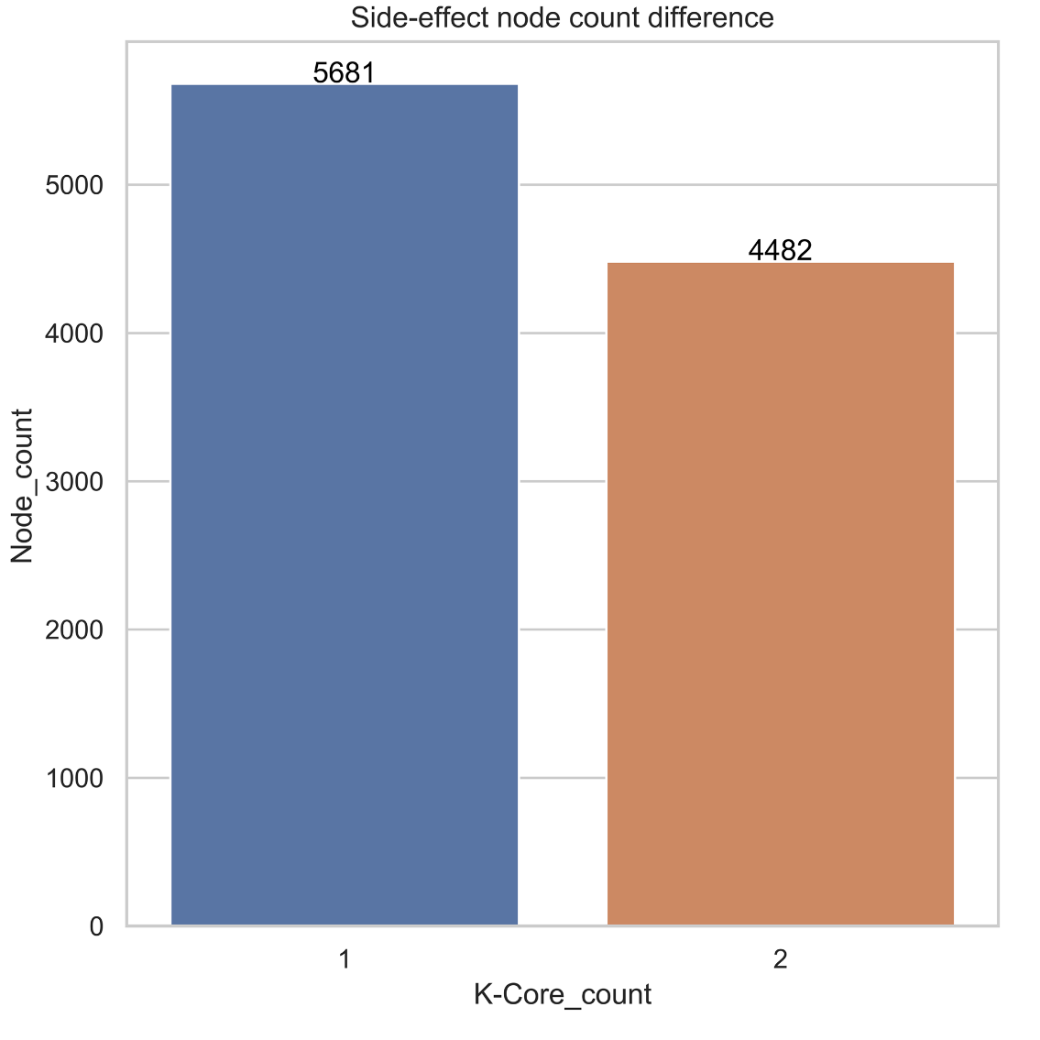
Degeneracy SNAP Program
Degeneracy is also known as the k-core number, width and linkage.
The concept of a k-core was introduced to study the clustering structure of social networks, but has applications in bioinformatics.
We use k-core to observe the number of side effects which are unique to any given drug.
1199 unique side effects

Slide 10
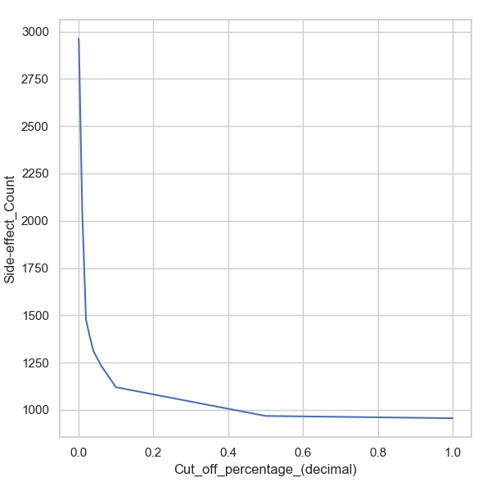
Thresholding (Own Program)
What we found was that the majority of side effects have very small chances of occurring
Using this, we can discover the more common side effects while filtering out ones with low chances of occurring
It is very useful for the consumer to look at the more typical side effects rather than the rare side effects

Slide 11
Drugs with most side effects
Drug | Side Effect
Pregabalin | 742
Aripiprazole | 741
Citalopram | 722
Ropinirole | 607
Risperidone | 588
Paroxetine | 550
Pramipexole | 611
Tramadol | 535
Gabapentin | 465
Fluoxetine | 493

Slide 12
Most common side effects
Side effects | Appearances | Degree Centrality
Nausea | 1207 | 0.131600
Headache | 1115 | 0.126770
Vomiting | 1087 | 0.125351
Dermatitis | 1096 | 0.125207
Rash | 1088 | 0.124853
Dizziness | 1035 | 0.123450
Diarrhoea | 981 | 0.119410
Asthenia | 910 | 0.117114
Pruritus | 948 | 0.114539
Abdominal pain | 828 | 0.107775

Slide 13
Future changes to dataset:
Weightings based on age, gender, weight, height etc
See if side effects are more/less likely based on any of these factors
Add the illness/impairment that is being treated using the drug
More informative at a lower level of knowledge, information would be useful to a consumer
Easier to compare drugs which are being used to treat the same illness
Drug pairing combinations
See how side effects change in frequency or in type when taking multiple drugs concurrently (polypharmacy)
There is an increased risk to the patient’s health and some combinations are not often observed, so recording them would be very useful research

